Slide 1
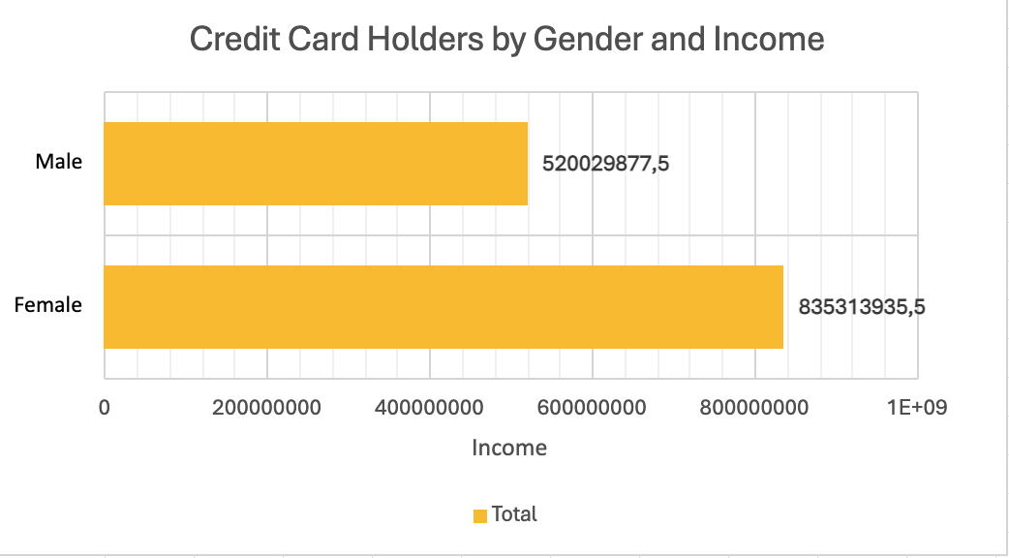
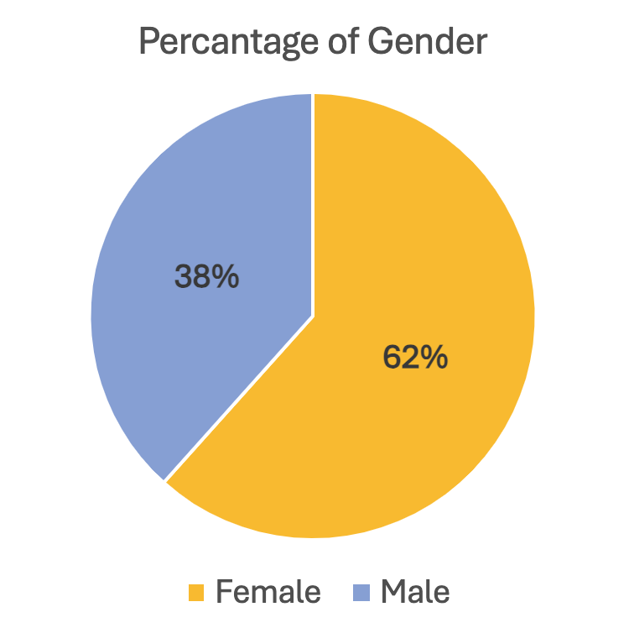
Credit Card Prediction
Unlocking Financial Access: Predicting Credit Card Eligibility
by Ahmet TURK
PROBLEM STATEMENT The credit card use market is on a constant rise worldwide. Correspondingly, your project manager wants to investigate the cardholder's status of cardholders, such as education, marital status, income, etc. and see how the kind of spending the cardholders spend. Using the dataset, find out the cardholder's spending materials.
The objective is to find out how cardholders use their credit cards changes over time in the world.
ANALYSIS The dataset includes 7293 rows and 18 columns, 9 of which contain numerical data and 9 of which contain textual data. While checking the blank (null) data, the percentage of the blank number is the highest, at 31%, in the job title. The percentage of female a credit card holder dominated at 67%, however, the male was 33%. When looking at the income and employment status of credit card holders, exactly 50% are classified as "working," followed by 27% as "commercial associate," and 14% as "pensioner," respectively. Basic statistics allow us to assess the distribution of the listings and compare it to our previous analysis based on review categories. The maximum revenue reveals a significant range of revenue (£1,575,000) yet a relatively modest mean (£185,867.226) and median (£157,500). Variance and standard deviation indicate a wide range of data. These findings imply an uneven ratio of success to failure, and further examination is warranted.
CONCLUSION When examining the broader context, it becomes evident that possessing a credit card does not correlate directly with demographic factors such as income, educational attainment, or occupational status. This observation is consistent with the findings gleaned from our dataset analysis. However, a closer inspection of gender reveals that women constitute a substantial majority, comprising 62% of individuals inclined towards opting for credit cards. Consequently, our analysis underscores gender as the most salient determinant within the dataset, suggesting a noteworthy influence on credit card ownership patterns.

